Slide 1
Just One: SoPra FS2020 Milestone 2
A Presentation from Group 15
Charlotte Eder, Minh Phuong Vu, Kai Mitiyamulle Arachchige, Jordan Cedeño, Raphael Haemmerli

Slide 2
Table of Contents
User Stories and Sprints
Diagrams
REST Specifications and Test Cases
User Interface Design Mock-ups

Slide 3
User Stories and Sprints
User Stories can be grouped into six categories.
Game-Logic
Game-Control
Player-Control
Non-Human Players
Information
Further Ideas

Slide 4
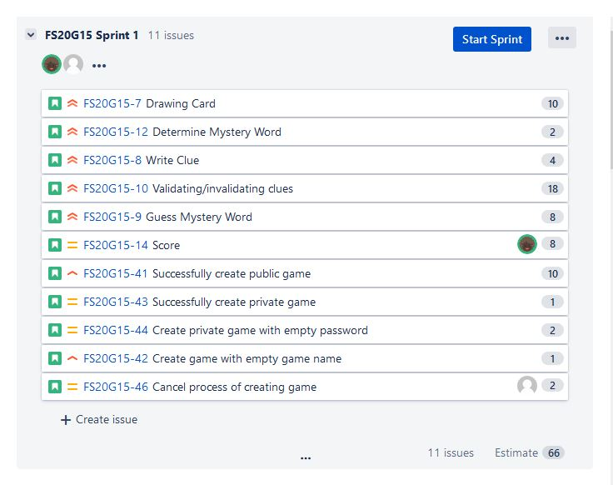
User Stories and Sprints
Five Sprints:
Game-Logic and Game-Control
Non-Human-Players and Game-Control
Player-Control and Game-Control
Information
Further Ideas
Frontend Team: Kai, Minh Phuong
Backend Team: Charlotte, Jordan, Raphael

Slide 5
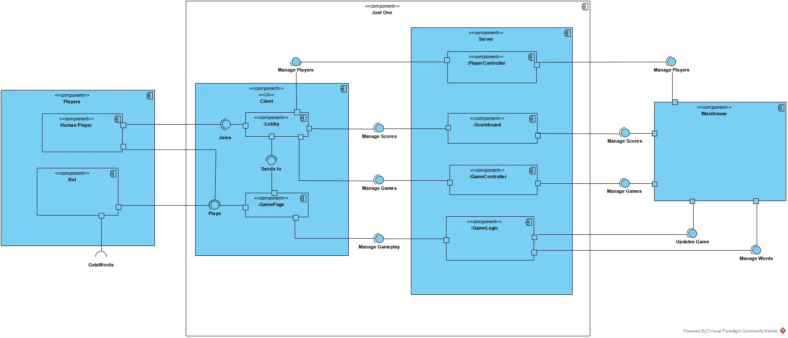
Diagrams
Component Diagram

Slide 6
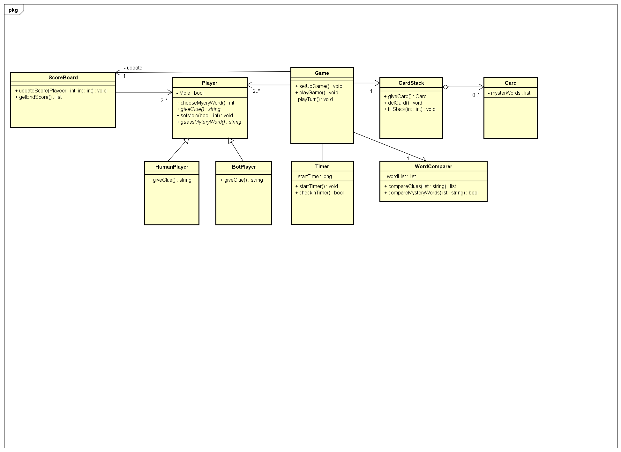
Diagrams
Class Diagram

Slide 7
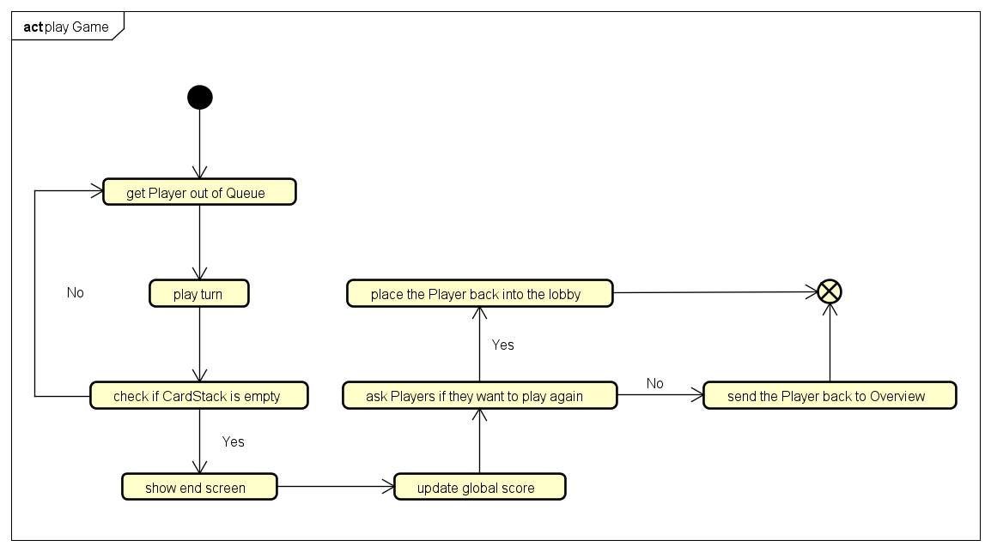
Diagrams
Activity Diagram (Game)

Slide 8
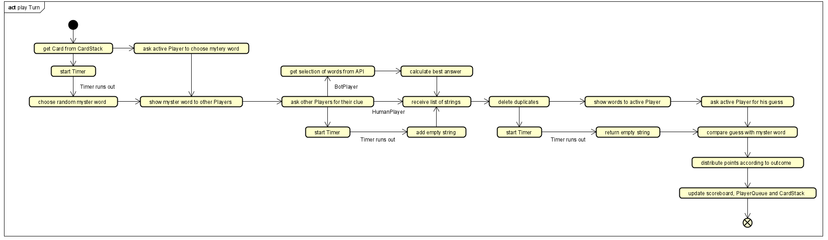
Diagrams
Activity Diagram (Turn)

Slide 9
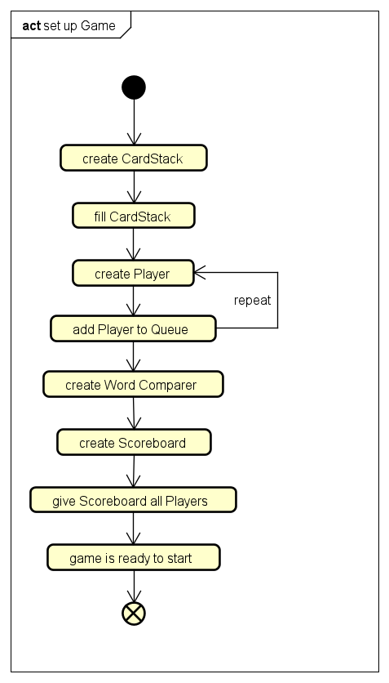
Diagrams
Activity Diagram (Create Game)

Slide 10
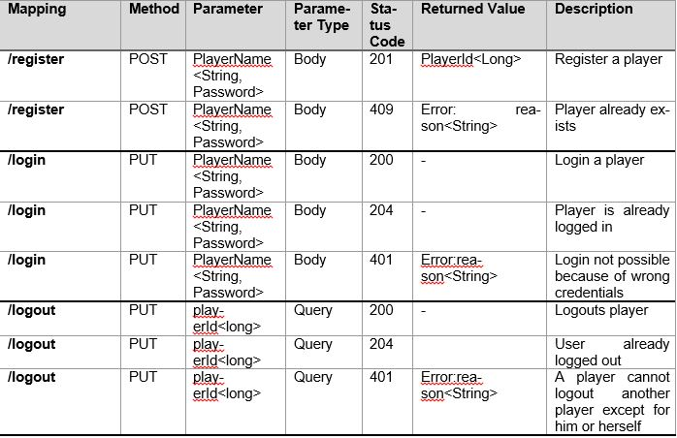
Rest Specifications and Test Cases

Slide 11
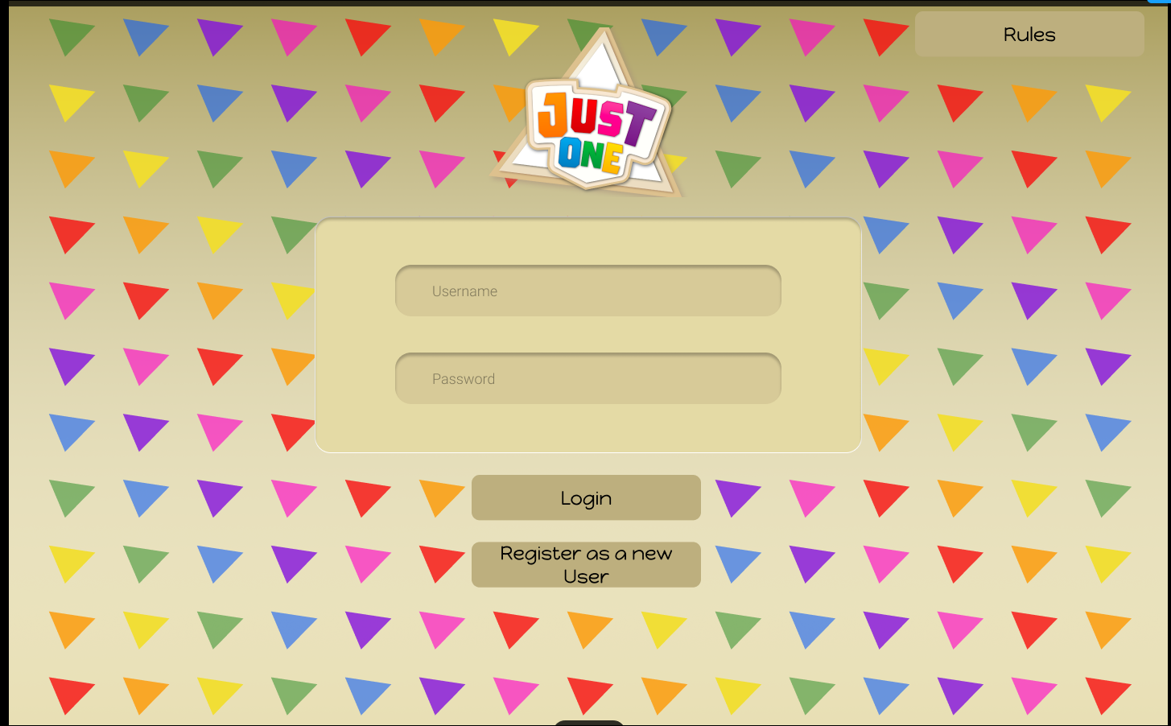
User Interface Design Mock-ups
Login Page

Slide 12
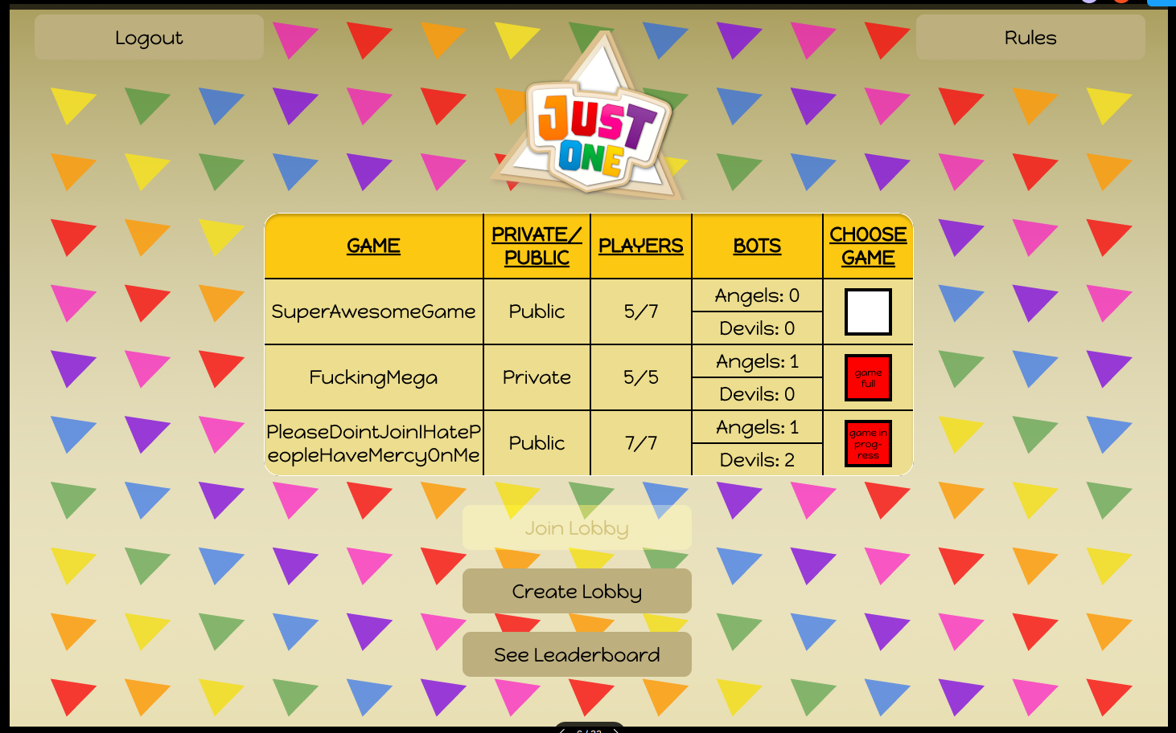
User Interface Design Mock-ups
Lobby Page

Slide 13
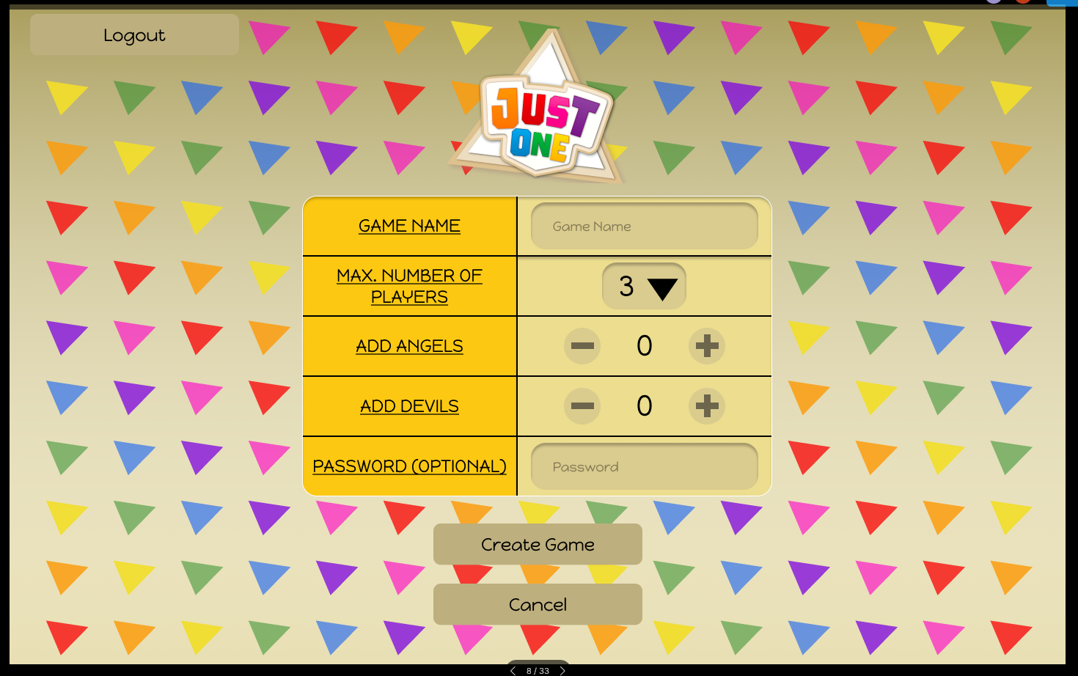
User Interface Design Mock-ups
Game Creation Page

Slide 14
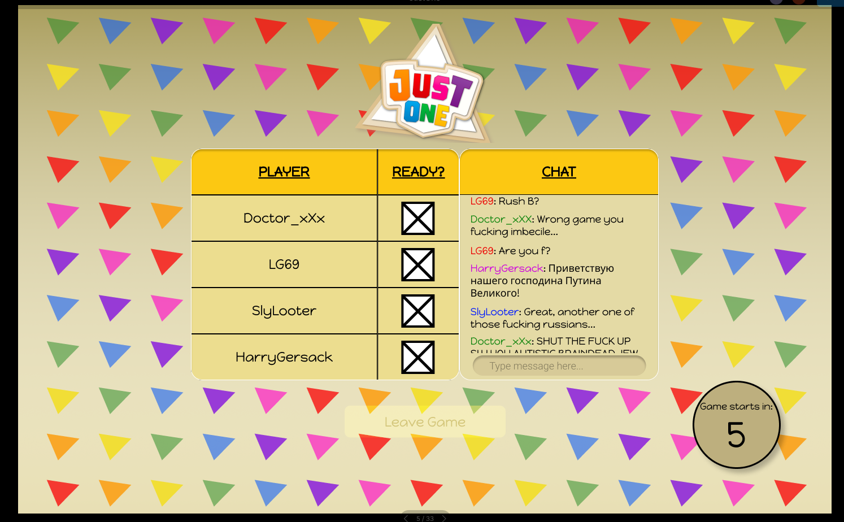
User Interface Design Mock-ups
Game Lobby Page

Slide 15
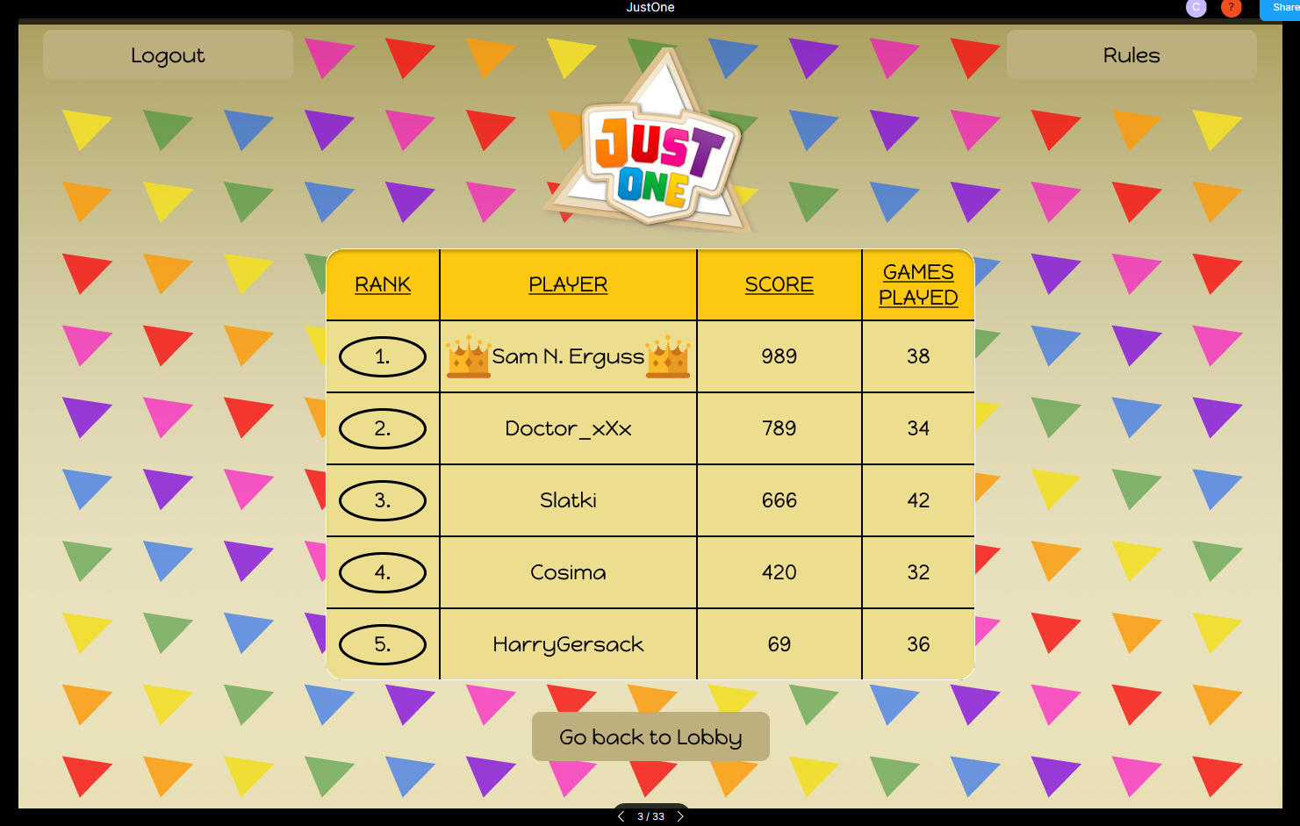
User Interface Design Mock-ups
Leader board Page

Slide 16
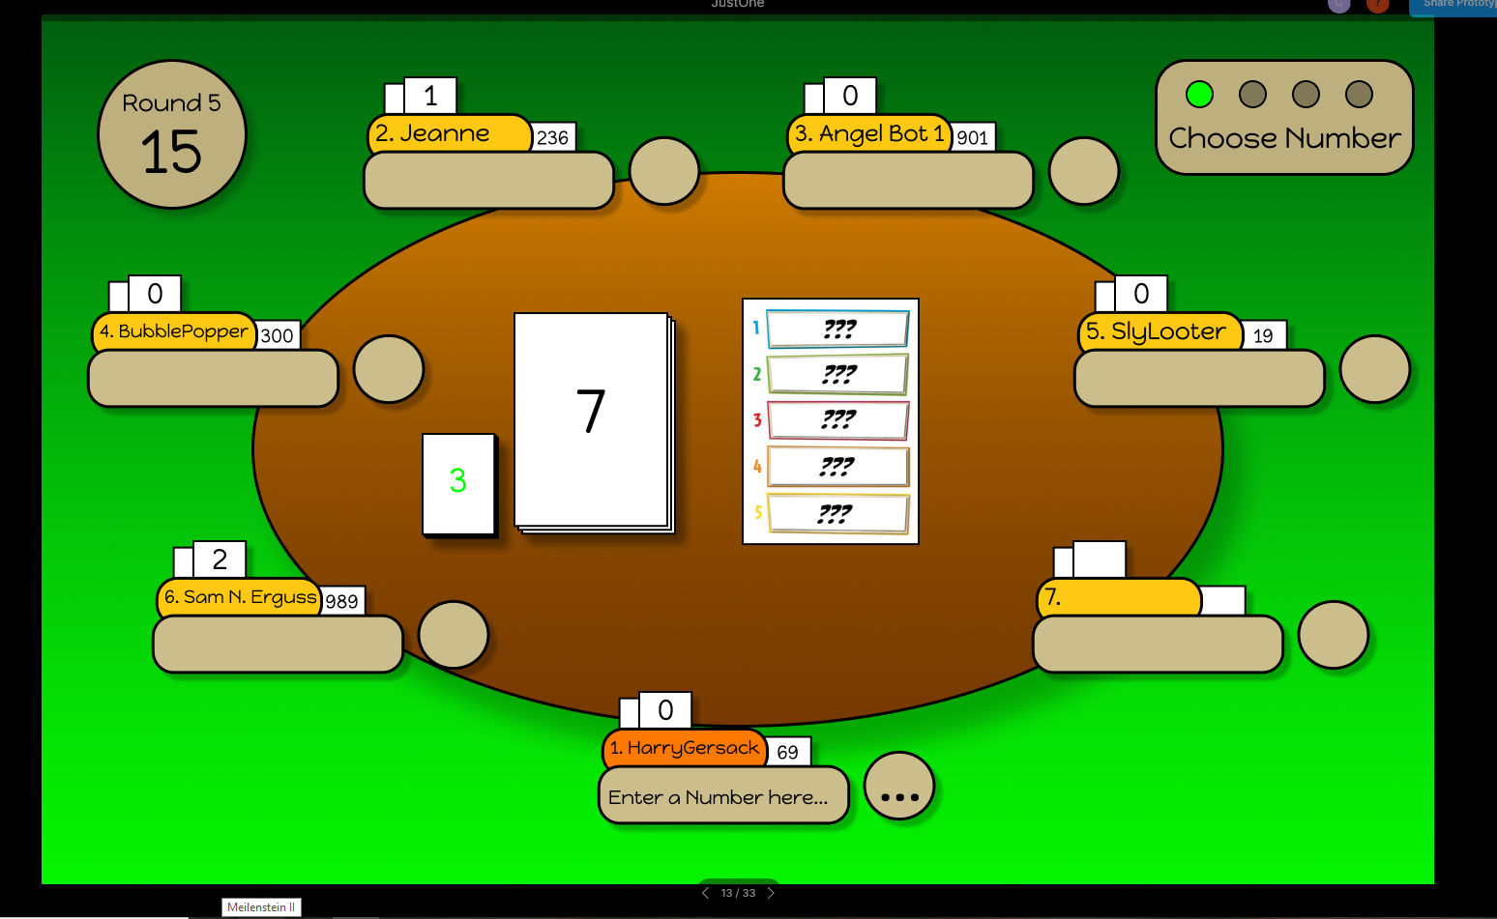
User Interface Design Mock-ups
Game Page: Choose Word

Slide 17
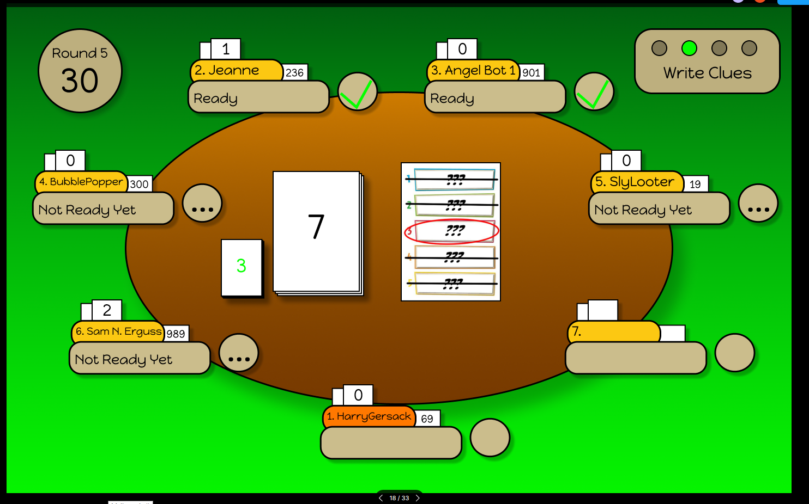
User Interface Design Mock-ups
Game Page: Write Clues

Slide 18
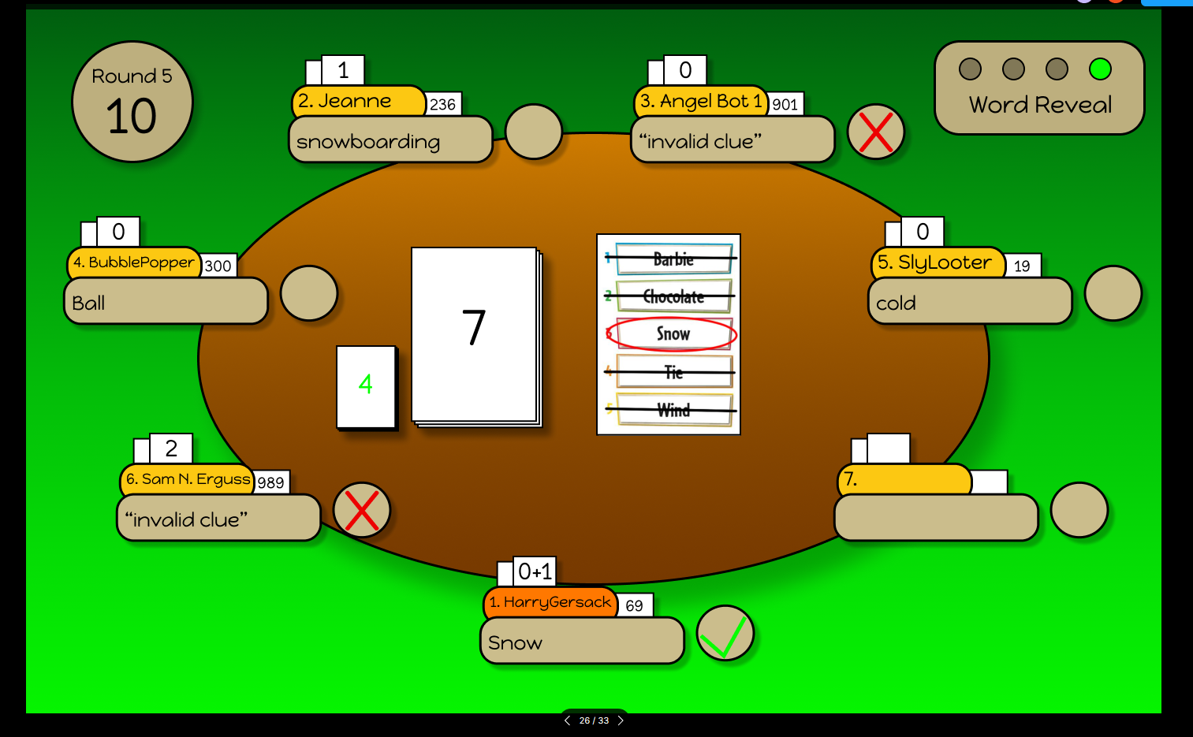
User Interface Design Mock-ups
Game Page: Guess Word

Slide 19
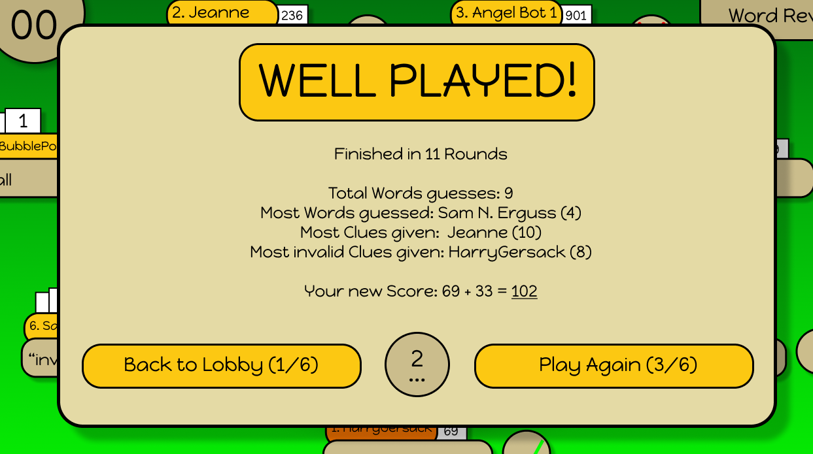
User Interface Design Mock-ups
Game Page: Game End

